Slide 1
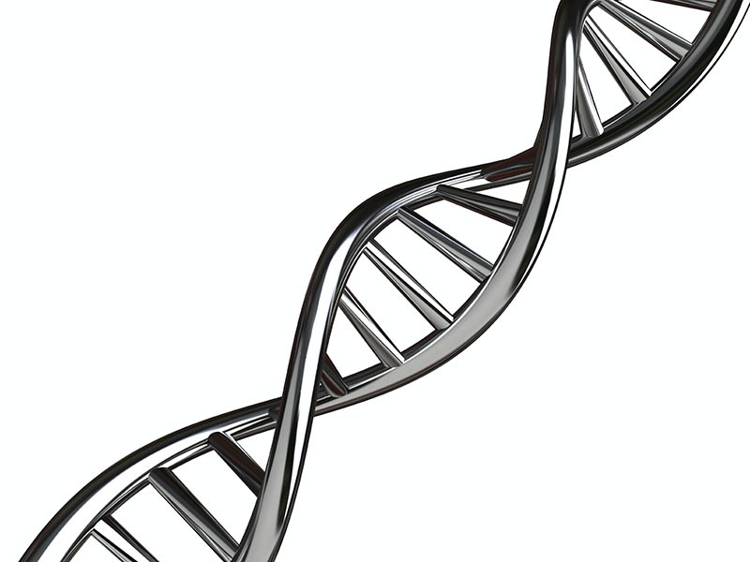

NGS Workshop
Dean Bobo
Sackler Institute for Comparative Genomics

Slide 2
About Me
Bioinformatics specialist at the Sackler Institute for Comparative Genomics (SIGC) at the AMNH
Previously at Stony Brook University, Mount Sinai School of Medicine
Genomics of humans, gibbons, dogs (ancient and modern), stickleback fish, and various plants
Lemur microbiomes
Estimating error rates of NGS variant identification

Slide 3
Overview
learn about FASTQs
visualize sequencing quality
trim reads (poor quality and adapters)
read mapping (to reference)
discuss de novo assembly

Slide 4
FASTQs
The FASTQ format is the de facto standard by which many sequencing instruments represent data.
It may be thought of as a variant of the FASTA format that allows it to associate a quality measure to each sequence base, FASTA with QUALITIES.

Slide 5
Each read in the FASTQ has 4 sections: (usually a single line for each)
A FASTA-like header. Starts with @ symbol. This is followed by an ID and more optional text
Sequence (typically on a single line), but it may be wrapped until the + sign starts the next section.
Quality Score Identifier: marked by the + sign and may be optionally followed by the same sequence id and header as the first section (but is often blank)
Quality Score Values for the sequence in section 2, and must be of the same length as section 2. It should (must?) also be wrapped the same way as the section 2.

Slide 6
Example FASTQ read
@GWNJ-0957:537:GW2001112798th:6:1101:5051:1379 2:N:0:GTAAGGTG+GCAATTCG
GAAAGTCTTCTTTCTTTTTTCTCTGATCTTGAACATCATTTTCAAATAAGGTTACATTATTTGAGTTAAGA
+
AAAAFF--AA-AF--7A-<-AJJFJFJ<JJJFFFF<FAFJJJFJJFJFA-<----<FF--7--<-F7JFFF

Slide 7
FASTQ quality scores
“Encoded” numerical values
each character represents a Phred score (explained on next slide)
!"#$%&'()*+,-./0123456789:;<=>?@ABCDEFGHI
| | | | | | | | |
0....5...10...15...20...25...30...35...40
| | | | | | | | |
worst................................best

Slide 8
Phred Scores
A Phred score Q is used to compute the probability of a base call being incorrect by the formula: P=10^(-Q/10).
Q | Error | Accuracy
0 | 1 in 1 | 0%
10 | 1 in 10 | 90%
20 | 1 in 100 | 99%
30 | 1 in 1000 | 99.9%
40 | 1 in 10,000 | 99.99%

Slide 9
Are FASTQ error values accurate?
Not really.
“In our observation the numbers are quite unreliable - treat them as an advisory rather than accurate measurements.”
-BioStarHandbook 2020
Notes:
Dr. István Albert

Slide 10
Paired End FASTQ files
sample.R1.fastq
sample.R2.fastq
READ 1 FORWARD
READ 1 REVERSE
READ 2 FORWARD
READ 2 REVERSE
READ 3 FORWARD
READ 3 REVERSE
READ N FORWARD
READ N REVERSE

Slide 11
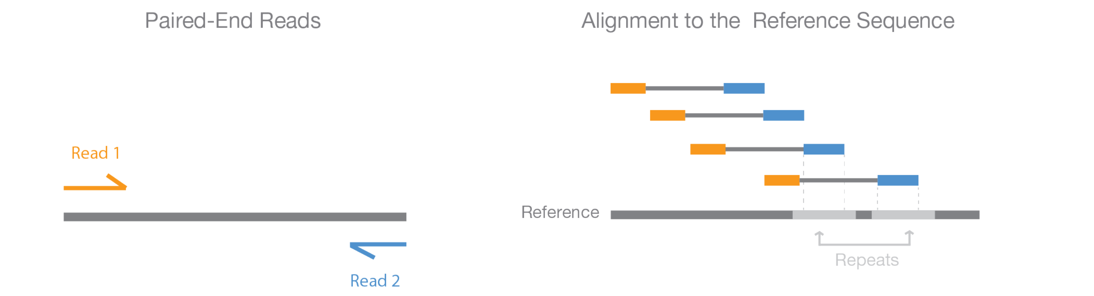
Paired-End Sequencing
Paired end sequencing enables both ends of the DNA fragment to be sequenced.
Since paired end distances are known, alignment algorithms can use this information to map the reads over repetitive regions more precisely.

Slide 12
Let’s start our virtual machines or log into the cluster
Open VirtualBox and start the virtual machine
Setup instructions are here: tinyurl.com/tad77jp
If you cannot VM, use Huxley?
Everyone needs to:
make sure sequencing data is downloaded
know what directory it is in (most likely ~/Downloads)

Slide 13
Clone my GIT repo
GIT is version control system. Use it!
cd ~/
git clone https://github.com/deanbobo/amnh-ngs-workshop.git

Slide 14
Turn Off Screen Lock on VM
Command line method:
source vm-setup.sh
GUI method:
Click bottom left task launcher
Type Screen Lock
Under Settings, click Privacy
Select Screen Lock
Turn Off

Slide 15

Open terminal and navigate to your FASTQs
Click Terminal app in taskbar on left
Use cd command to go to directory where your data lives
cd ~/amnh-ngs-workshop
Use ls command to list files in that directory:
ls –lh
that is an l for long
the h makes the file sizes human readable

Slide 16
Move FASTQs into Workshop Directory
go to location of your FASTQ files using cd command
cd ~/Downloads #likely to be in downloads folder
move the files with the mv command
mv *.fastq.gz ~/amnh-ngs-workshop

Slide 17
Some Linux Command Line Hints
Use the up arrow on your keyboard to see (and run) previous commands
Use the tab key to autocomplete file names (and executables in the path)

Slide 18
File Types
fastqs are often delievered as a compressed “gzipped” file.
Most softwares that work with FASTQs can work with gzipped files.
To unzip them to a plain text file (ASCII), this is the command:
gunzip file.R1.fq.gz #don’t gunzip files if storage is low
gunzip file.R2.fq.gz
To rezip them (to save space):
gzip file.R1.fq
gzip file.R2.fq

Slide 19
File Types
Linux does not care about filename suffixes
a compressed file can live with the name file.R1.fq OR file.R1.fq.gz OR file.R1.anything
To find the file type, use the file command. Examples:
file myfilenamehere.fq.gz
file what.am.i

Slide 20
look at the FASTQ file
Less can be used to look at a file’s contents.
It can read many compressed files (but not all)
less ﻿Picon-19C-AC05_R1_001.fastq.gz

Slide 21
How many reads do you have?
Use this command to count number of reads:
echo $(zcat file.R1.fastq.gz|wc -l)/4|bc
echo $(zcat file.R2.fastq.gz|wc -l)/4|bc

Slide 22
Sequencing Quality Control
Quality control (QC) is the process of improving data by removing identifiable errors from it.
It is typically the first step performed after data acquisition.
It is common to expect too much from quality control. Remember that QC cannot turn bad data into useful data and we can never salvage what appears to be a total loss.

Slide 23
Is QC Important?
The more unknowns about the genome under study, the more critical it is to correct any errors.
When aligning against well-studied and known genomes, we can recognize and identify errors by their alignments. When assembling a de novo genome, mistakes can derail the process; hence, it is more important to apply a higher stringency for filtering.

Slide 24
QC typically follows this process:
Evaluate (visualize) data quality.
Stop and move to the next analysis step if the quality appears to be satisfactory.
If not, execute one or more data altering steps then go to step 1.

Slide 25
Evalulate Data Quality
Use fastqc to visualize data quality
fastqc file_R1.fastq.gz file_R2.fastq.gz
ls –ltrh #notice the html files generated
t sorts by time
r puts the newest files at the bottom
firefox file_R1.fastqc.html #notice the modified suffix
firefox file_R2.fastqc.html

Slide 26
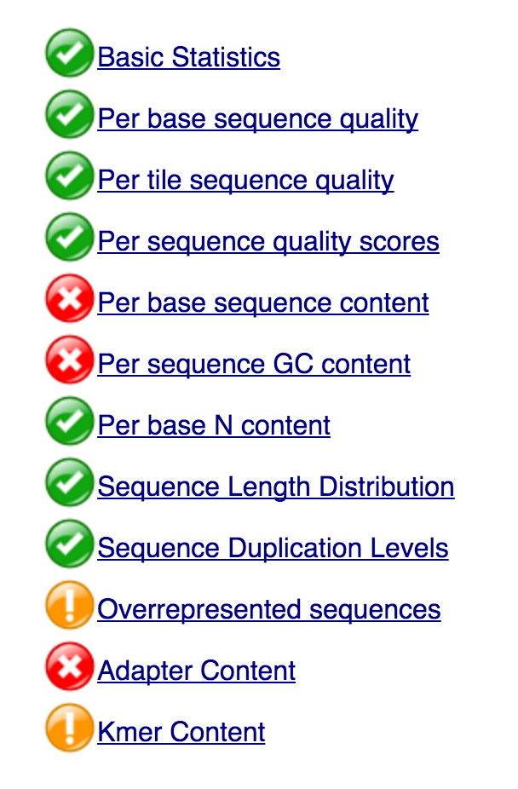
Should I be worried about the “stoplight” symbols?
Usually not.
When FastQC runs, it generates “stoplight” icons for each analysis having “pass,” “warning,” and “error” symbols.
Most of the time, these symbols are not meaningful. They were developed for only a particular class of samples and library preparation methods and just for certain types of instruments.
But if most or all your stop light icons are red, then you probably have a data problem.

Slide 27
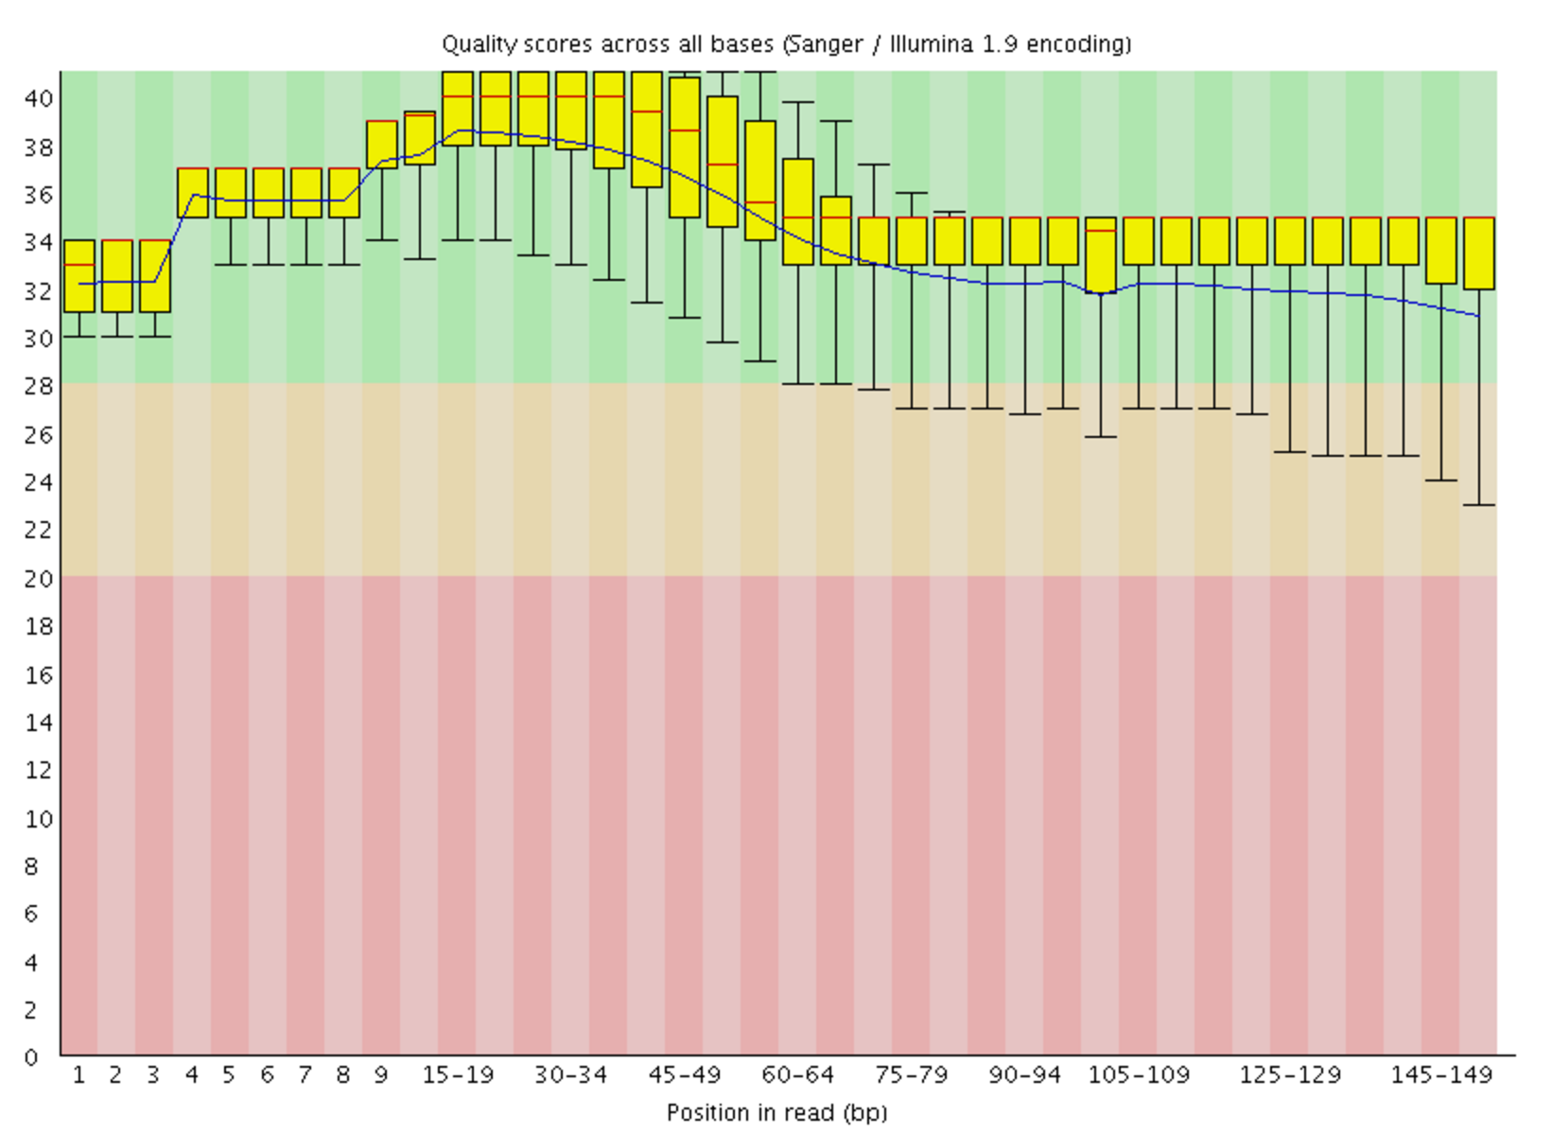
Quality Scores Across All Bases
The simplest way to snapshot the quality of a sequencing run is via a chart that plots the error likelihood at each position averaged over all measurements.
Reliable
Less Reliable
Error Prone

Slide 28
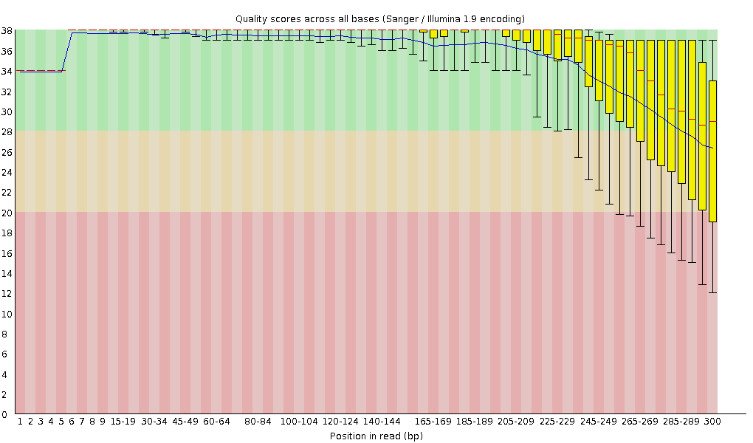
Decreased quality towards tails of reads

Slide 29
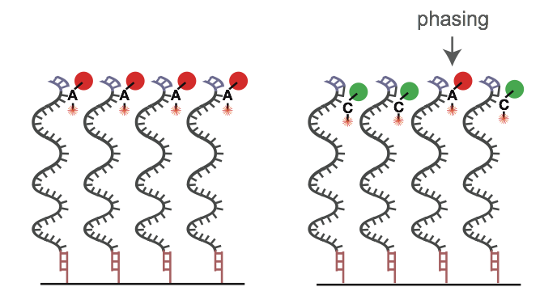
Phasing
Phasing means that the blocker of a nucleotide is not correctly removed after signal detection.
Molecule 3 on the right is one cycle behind the rest and will pollute the light emitted from the cluster.
1 2 3 4 1 2 3 4

Slide 30
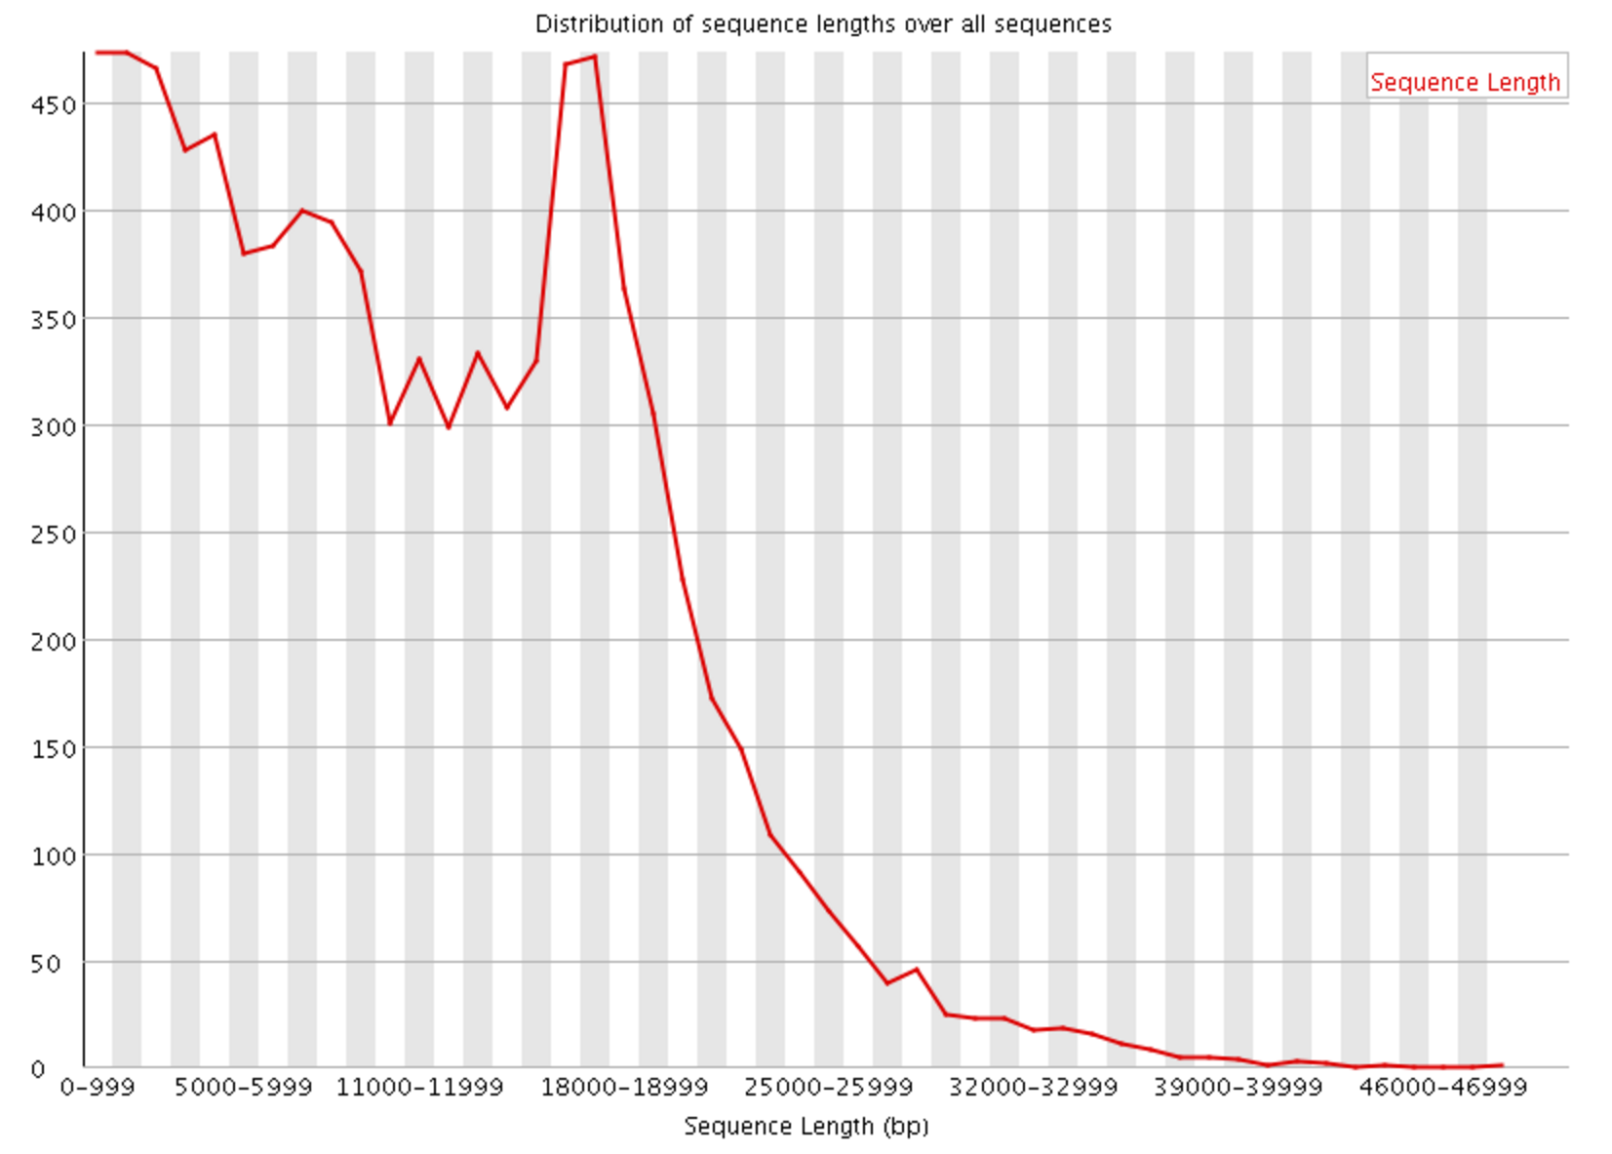
Sequence Length
The sequence length distribution shows how many sequences of each length the data contains.
For fixed read length instruments (Illumina sequencer), all read lengths are the same.
For long read technologies like the PacBio and MinION, the distribution can be a lot more varied.

Slide 31
QC tools to know about
A considerable number of QC tools have been published.
Recommend: Trimmomatic, BBDuk ,flexbar and cutadapt
Others in alphabetical order:
BBDuk part of the BBMap package
BioPieces a suite of programs for sequence preprocessing
CutAdapt application note in Embnet Journal, 2011
fastq-mcf published in The Open Bioinformatics Journal, 2013
Fastx Toolkit: collection of command line tools for Short-Reads FASTA/FASTQ files preprocessing - one of the first tools
FlexBar, Flexible barcode and adapter removal published in Biology, 2012
NGS Toolkit published in Plos One, 2012
PrinSeq application note in Bioinformatics, 2011
Scythe a bayesian adaptor trimmer
SeqPrep - a tool for stripping adaptors and/or merging paired reads with overlap into single reads.
Skewer: a fast and accurate adapter trimmer for next-generation sequencing paired-end reads.
TagCleaner published in BMC Bioinformatics, 2010
TagDust published in Bioinformatics, 2009
Trim Galore - a wrapper tool around Cutadapt and FastQC to consistently apply quality and adapter trimming to FastQ files, with some extra functionality for MspI-digested RRBS-type (Reduced Representation Bisufite-Seq) libraries
Trimmomatic application note in Nucleic Acid Research, 2012, web server issue

Slide 32
Read Trimming
pseudocode:
TrimmomaticPE R1.fastq.gz \
R2.fastq.gz \
R1.trimmed.fastq.gz \
R1.unpaired.fastq.gz \
R2.trimmed.fastq.gz \
R2.unpaired.fastq.gz \
SLIDINGWINDOW:4:20
actual code:
TrimmomaticPE Groth-07C-JG2_R1_001.fastq.gz Groth-07C-JG2_R2_001.fastq.gz Groth-07C-JG2_R1_001_trimmed.fastq.gz Groth-07C-JG2_R1_unpaired.fastq.gz Groth-07C-JG2_R2_001_trimmed.fastq.gz Groth-07C-JG2_R2_001_unpaired.fastq.gz SLIDINGWINDOW:4:20

Slide 33
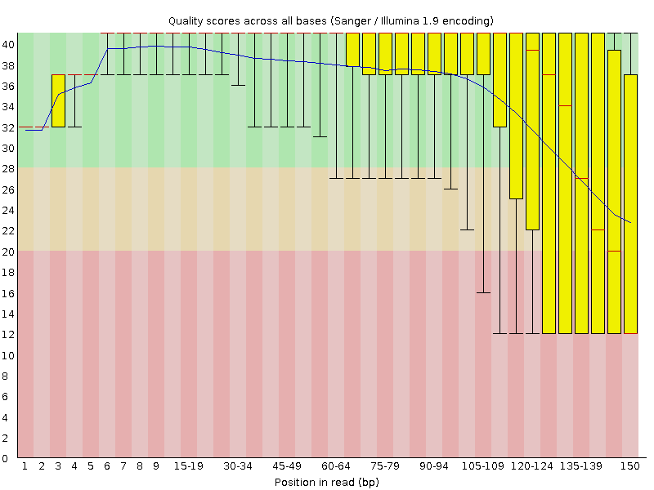
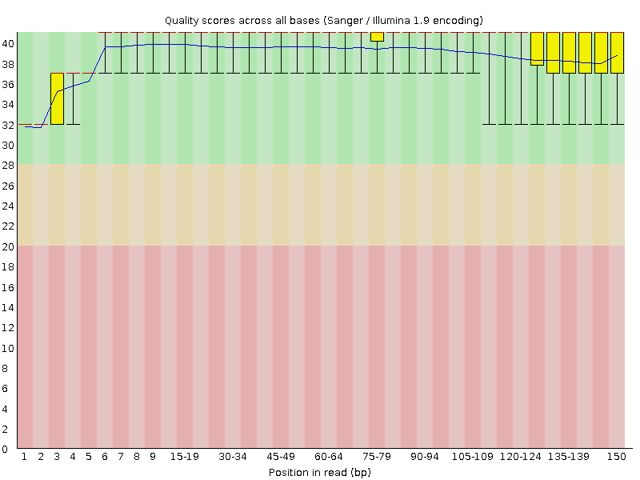
Before and After Trimming

Slide 34
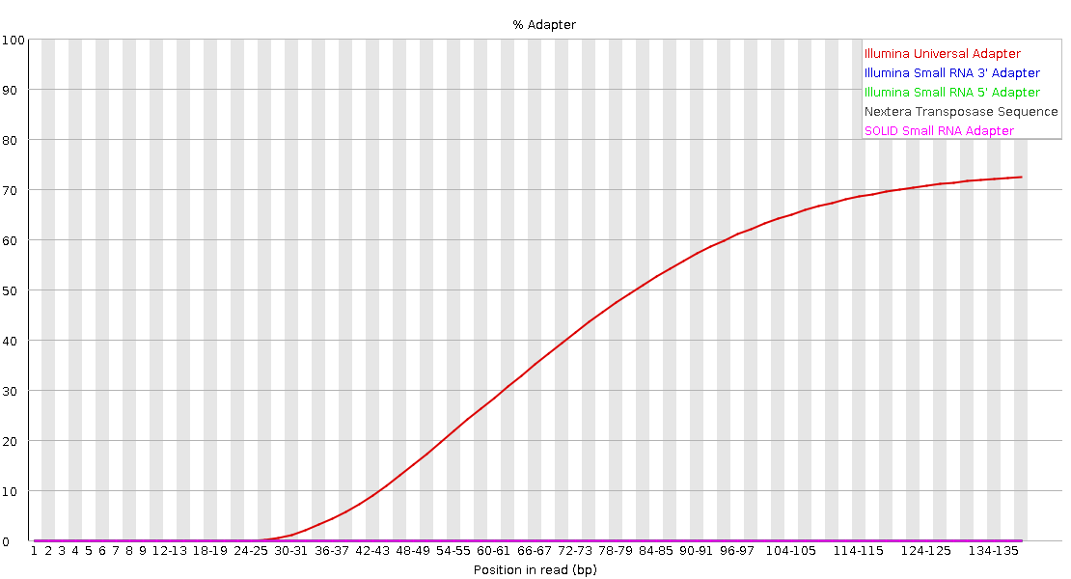
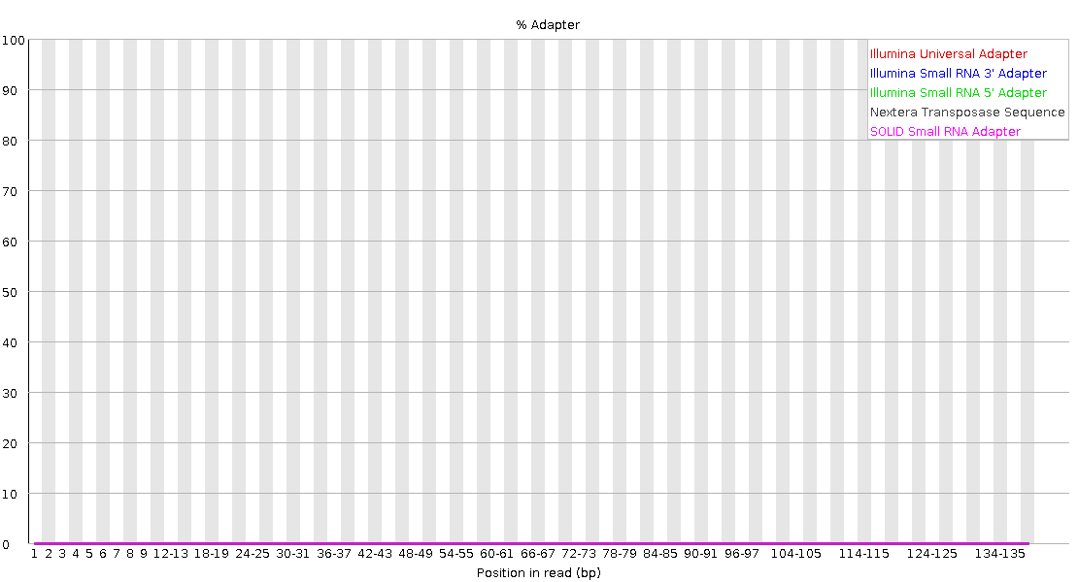
Before adapter removal
After adapter removal

Slide 35
Remove Adapters
pseudocode:
﻿cutadapt -a AGATCGGAAGAG \ #Illumina universal adapter
-o R1.trimmed.cutadapt.fastq.gz \ #output forward
-p R2.trimmed.cutadapt.fastq.gz \ #output reverse
in.R1.trimmed.fastq.gz \ #input forward
in.R2.trimmed.fastq.gz #input reverse
code example:﻿
cutadapt -a AGATCGGAAGAG -o Groth-07C-JG2_R1_001_trimmed.cutadapt.fastq.gz -p Groth-07C-JG2_R2_001_trimmed.cutadapt.fastq.gz Groth-07C-JG2_R1_001_trimmed.fastq.gz Groth-07C-JG2_R2_001_trimmed.fastq.gz

Slide 36
Let’s map a genome (but don’t get crazy)
Download files from my git repository
git clone ﻿https://github.com/deanbobo/amnh-ngs- workshop.git
cd amnh-ngs-workshop
Decompress the fasta file
gunzip ﻿canFam3.1.MT.fa.gz

Slide 37
Create Index Files
BWA index files
bwa index ﻿canFam3.1.MT.fa
Samtools index file
samtools faidx ﻿canFam3.1.MT.fa
Create a Sequence Dictionary
﻿ picard-tools CreateSequenceDictionary R= canFam3.1.MT.fa O= canFam3.1.MT.dict

Slide 38
BWA MEM aligner
bwa is a short read aligner. It requires an indexed reference genome (bwa index command from previous slide)﻿
bwa mem –R '@RG\tID:coyote\tSM:coyote\tLB:coyote\tPL:Illumina' canFam3.1.MT.fa coyote.R1.MT.fq.gz coyote.R2.MT.fq.gz -t 2 | samtools view -bS - > coyote.MT.bam

Slide 39
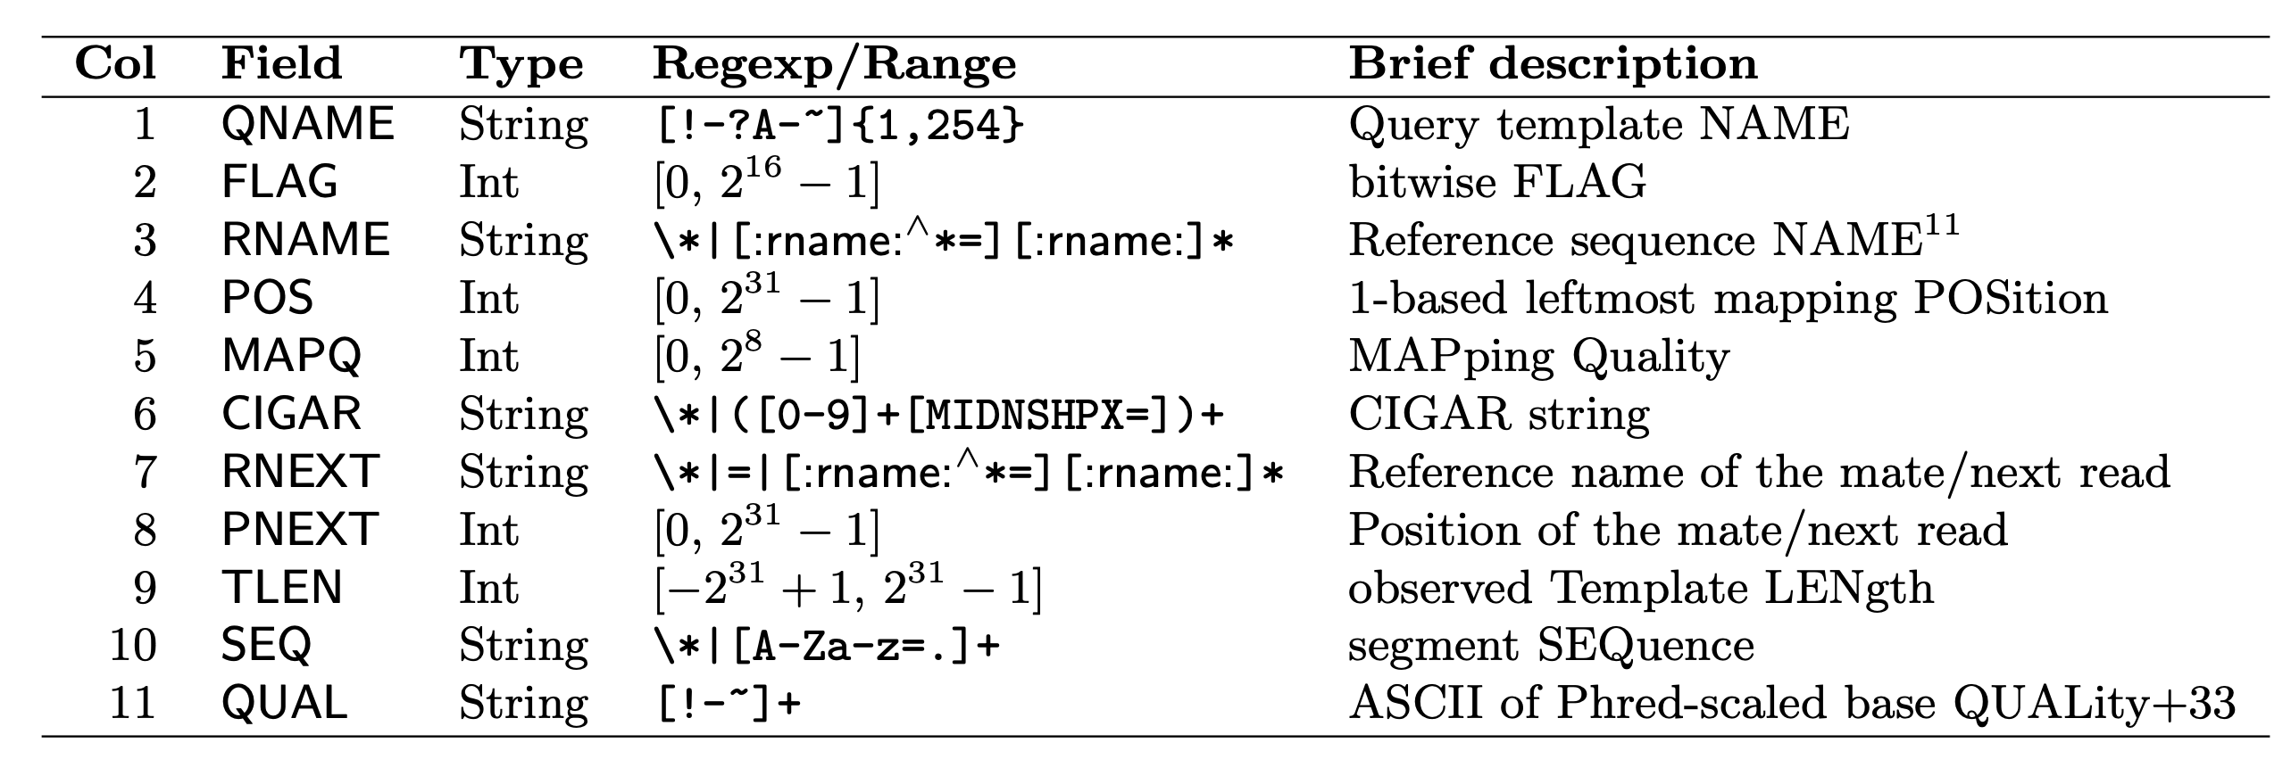
SAM/BAM format
SAM format :https://samtools.github.io/hts-specs/SAMv1.pdf
Tab separated file. One line per read. These are the columns:

Slide 40
Some basic BAM info
samtools flagstat coyote.MT.bam
﻿112788 + 0 in total (QC-passed reads + QC-failed reads)
0 + 0 secondary
670 + 0 supplementary
0 + 0 duplicates
112782 + 0 mapped (99.99% : N/A)
112118 + 0 paired in sequencing
56059 + 0 read1
56059 + 0 read2
109626 + 0 properly paired (97.78% : N/A)
112106 + 0 with itself and mate mapped
6 + 0 singletons (0.01% : N/A)
0 + 0 with mate mapped to a different chr
0 + 0 with mate mapped to a different chr (mapQ>=5)

Slide 41
Some more BAM work
View a BAM file
samtools view coyote.MT.bam | less –S
Sort a BAM file
﻿samtools sort -o coyote.MT.sorted.bam coyote.MT.bam
Index the alignment
samtools index coyote.MT.sorted.bam

Slide 42
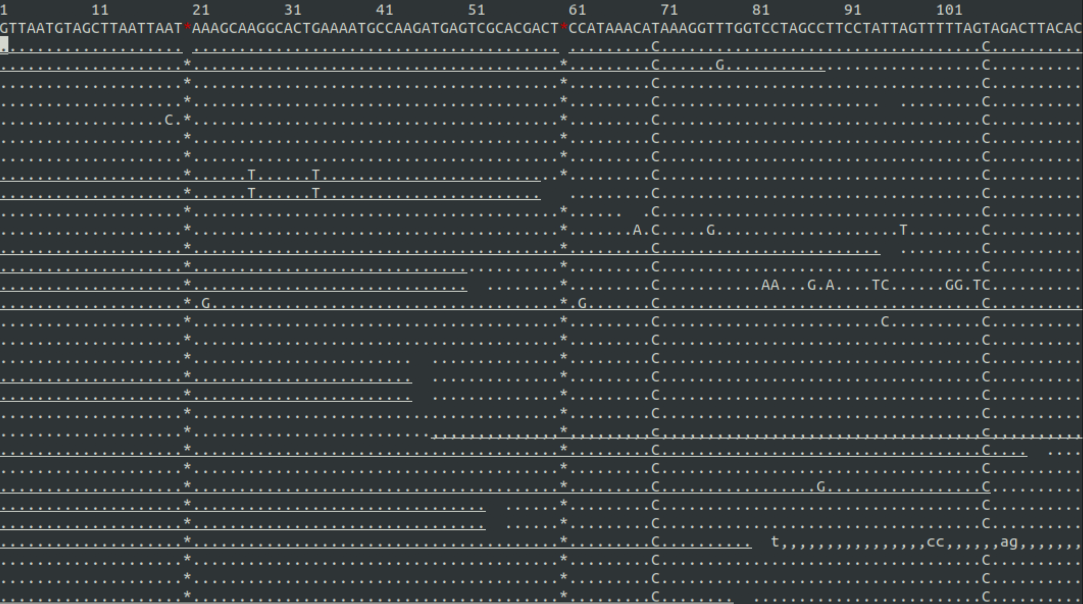
Visualizing a BAM
Press the question mark for the help menu. Q key to hide the help menu.
samtools tview coyote.MT.sorted.bam
If reference genome is provided, first line is ref. Otherwise, first line is consensus.
Consensus sequences often have IUPAC codes.

Slide 43
IUPAC code | Base
A | Adenine
C | Cytosine
G | Guanine
T (or U) | Thymine (or Uracil)
R | A or G
Y | C or T
S | G or C
W | A or T
K | G or T
M | A or C
B | C or G or T
D | A or G or T
H | A or C or T
V | A or C or G
N | any base

Slide 44
GATK Best Practices

Slide 45
Questions & Help
Dean Bobo
deanbobo@gmail.com or dbobo@amnh.org
github.com/deanbobo

Slide 46
FASTQ: Wrapped Text > Unwrapped text
Use the fastx_toolkit
fasta_formatter –i input.fastq –o output.fastq –w 0

